Slide 1


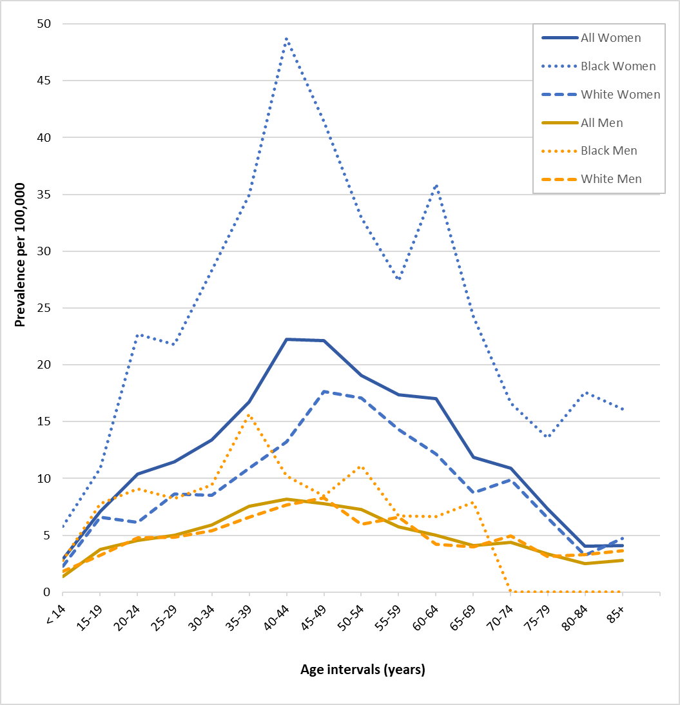

Estimating the prevalence of neuromyelitis optica spectrum disorder using
28.7 million electronic health records from the United States
Jacqueline K. Shaia, MS ^{1,2}, Farren Briggs, PhD ScM ²
1 Center for Ophthalmic Bioinformatics, Cleveland Clinic Foundation; 2. Department of Population and Quantitative Health Sciences, Case Western Reserve University School of Medicine
Introduction
Women are disproportionately affected by NMOSD, with Black Americans women being the most burdened
Results
Neuromyelitis optic spectrum disorder (NMOSD): rare demyelinating, autoimmune disease
Characterized by unpredictable inflammatory events of the optic nerves and spinal cord
2011 prevalence of NMOSD in Olmstead County (N=145,979) to be 4/100,000 in White residents and 13/100,000 in Black residents
There are no other estimates of NMOSD in Americans
2021 Prevalence per 100,000
Total population: 9.1 (CI: 8.8, 9.5)
Black Americans: 17 (CI: 15.8, 18.1)
Asian Americans: 10 (CI: 7.9, 12.1)
White Americans: 7.3 (CI: 6.9, 7.7)
Prevalence Among Women
Total population: 12.6 (CI: 12.1, 13.2)
Black Americans: 24.8 (CI: 23, 26.7)
Asian Americans: 14 (CI: 10.7, 17.4)
White Americans: 9.5 (CI: 8.9, 10.1)
Prevalence Among Men
Total population: 4.6 (CI: 4.3, 5)
Black Americans: 5.9 (CI: 4.9, 7)
Asian Americans: 4.9 (CI: 2.6, 7.1)
White Americans: 4.5 (CI: 4.1, 5)
Prevalence Ratios
PR in Black Americans compared to White Americans: 2.3 (CI: 2.1, 2.5)
PR in Asian Americans compared to White Americans: 1.3 (CI: 1.1, 1.7)
Black (PR=2.6 [CI: 2.4, 2.9]) and Asian (PR=1.5 [CI: 1.2, 1.9]) women had a higher burden than White women
Black (PR=1.3 [CI: 1.1, 1.6] but not Asian (PR=1.1 [CI: 0.7, 1.7]) men had a burden than White men.
Purpose
To characterize the prevalence of NMOSD in the U.S. in 2021, including by age, sex, and race.
Methods
TriNetX Research Network – U.S. private research network contains data from 55 healthcare organizations
28,705,949 patients in 2021
NMOSD patients were defined by ICD-10 Code GM36.0
Counts by age intervals, sex, and race combinations were extracted to calculate prevalence per 100,000
95% Confidence Intervals were calculated
Conclusions
2021 prevalence of NMOSD is 9.1/100,000, which is substantially higher than prior estimates.
Women are disproportionately affected by NMOSD (~3x) than men, particularly Black women who had the highest prevalence across all ages
My Website
Acknowledgements. We express our gratitude to MetroHealth and Dr. David Kaelber for access to the TriNetX Network
Figure. The 2021 prevalence of NMOSD in TriNetX by sex and race
Funding: This project was generously supported by the Connor B. Judge Foundation and the Clinical and Translational Science Collaborative (CTSC).
CTSC is funded by the National Institutes of Health, National Center for Advancing Translational Science, Clinical and Translational Science Award grant, UL1TR002548).

